Slide 1
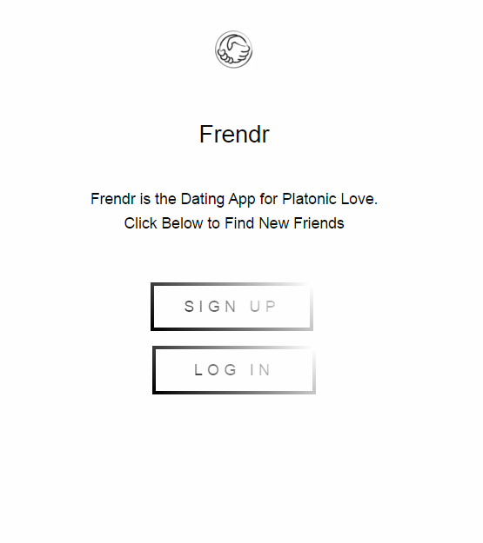

Slide 2

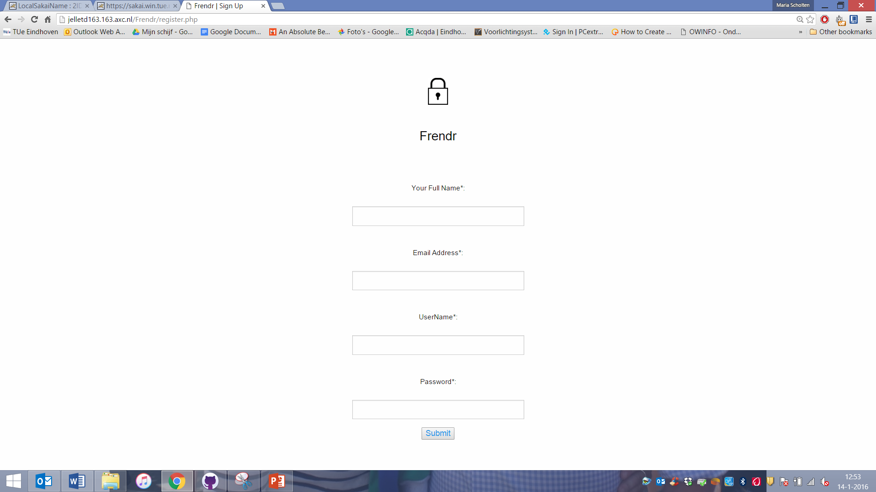
Frendr
Create your own profile
Make friends based on matches
Start chatting!

Slide 3
Front-end Design
Foundation → Homepage, Log In Page & Sign Up Page
Bootstrap → Profile Page
Javascript → Throughout the whole website
JQuery Library → Throughout the whole website

Slide 4
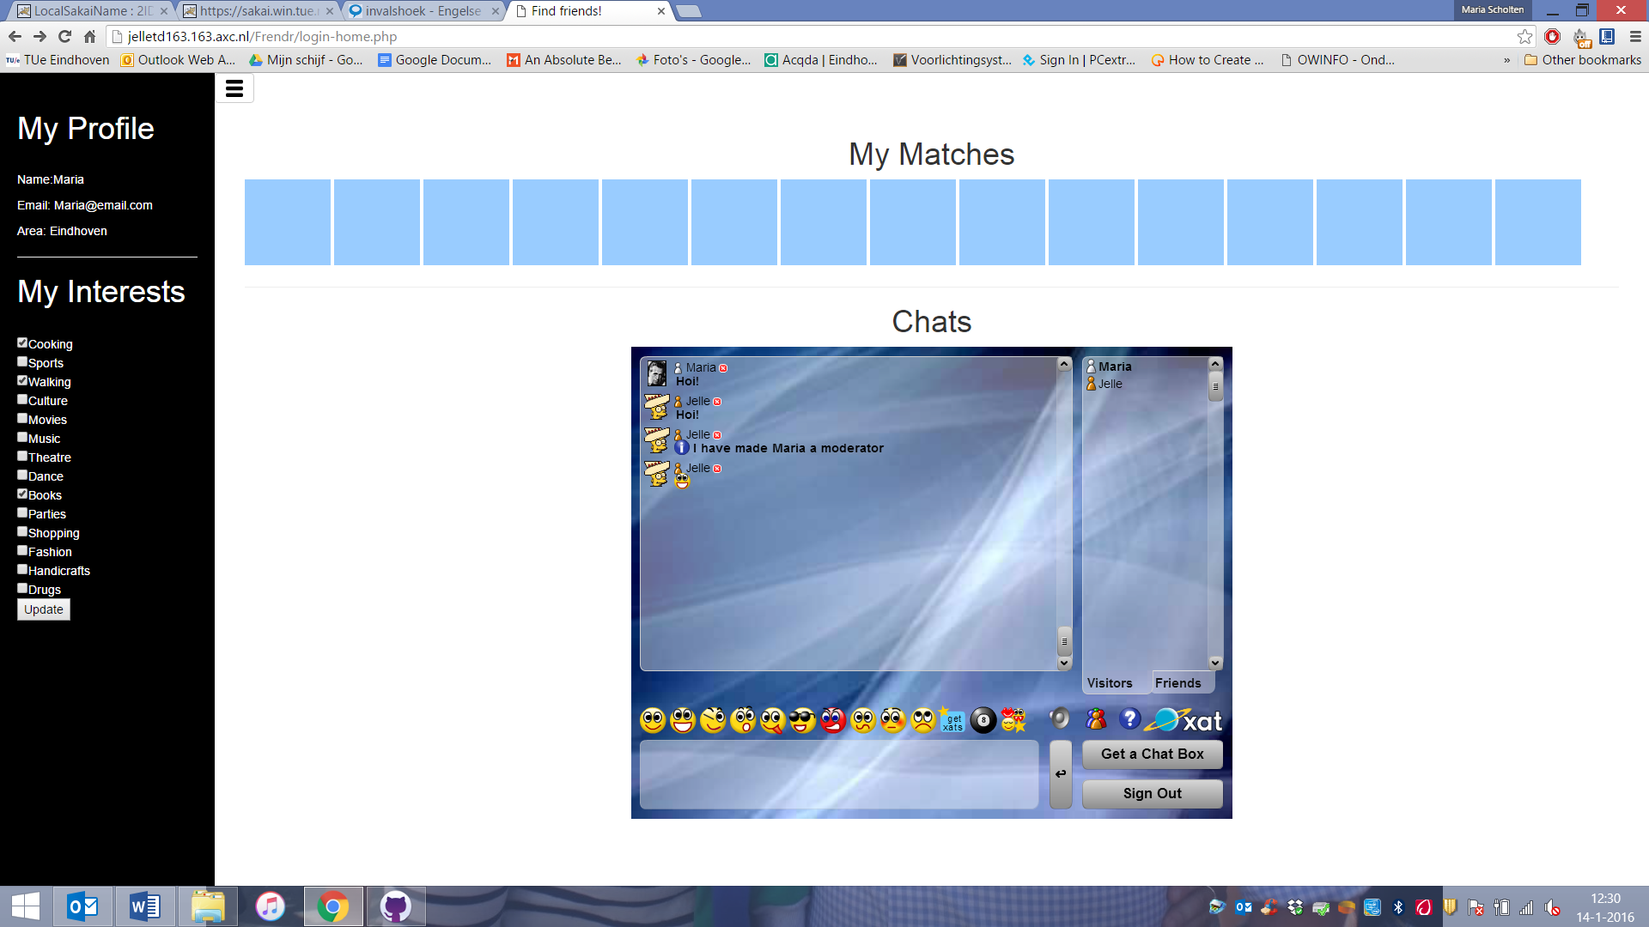
Back-end Design
Ruby on Rails
PHP for handling the user interactions

Slide 5
Databases
SQLite
Two tables → one for user information, one for user interests
Connection through PHP

Slide 6
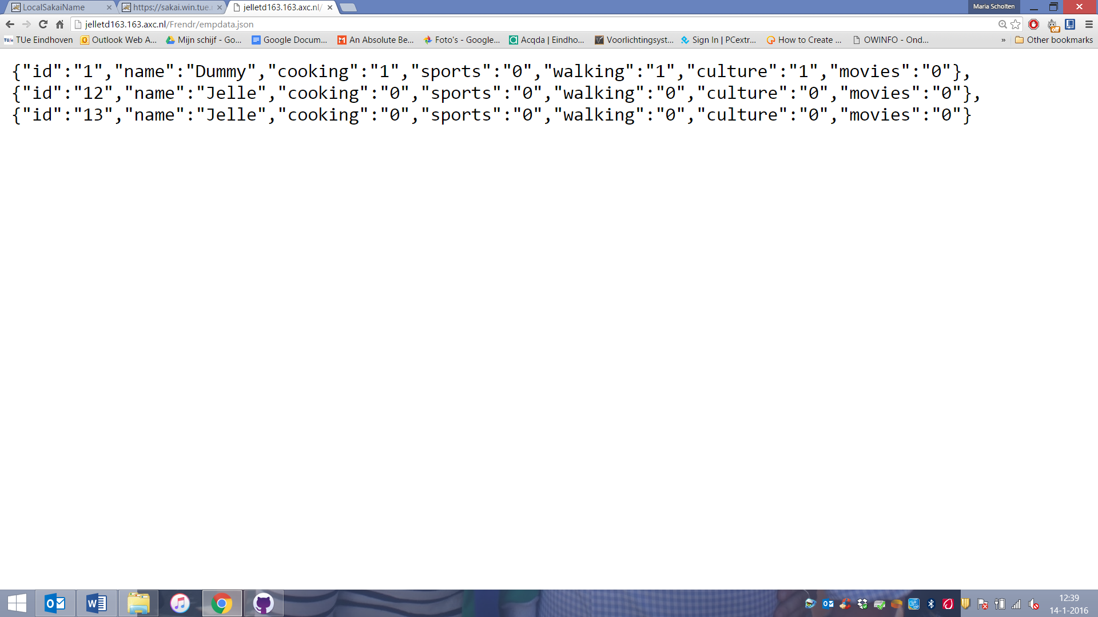
REST APIs
We provide our own API!
Shows user name and interests
Is used to run the matching algorithm

Slide 7
Time for our demo!
Provide URL to screencast

